Slide 1
Lesson 3
精讲听力
雅思听力组

Slide 2

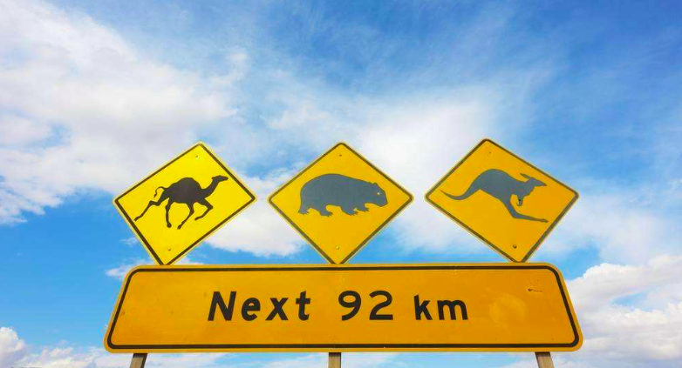
Traveling

Slide 3

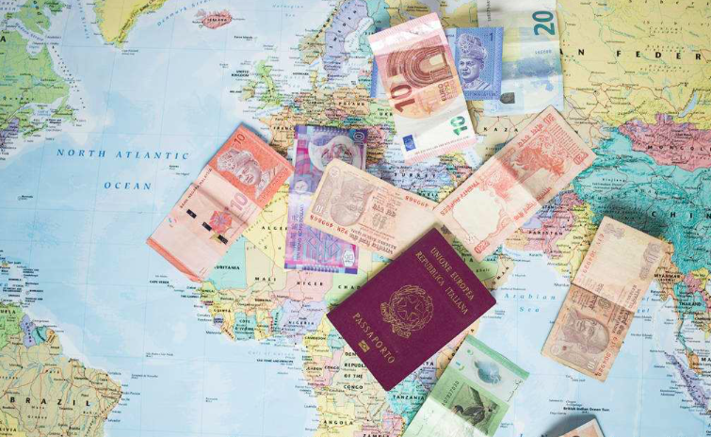

Before Traveling ...
Make a plan --
Destination
Accommodation
Budget
...

Slide 4
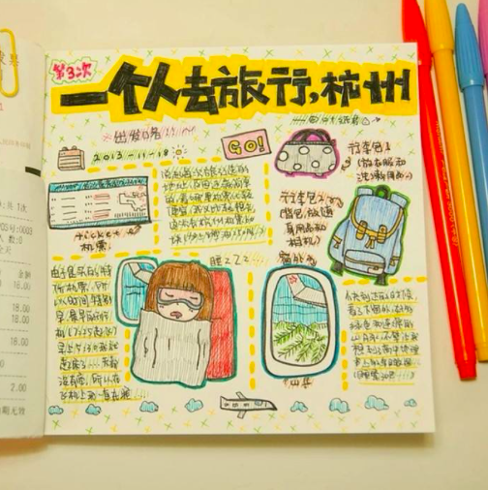
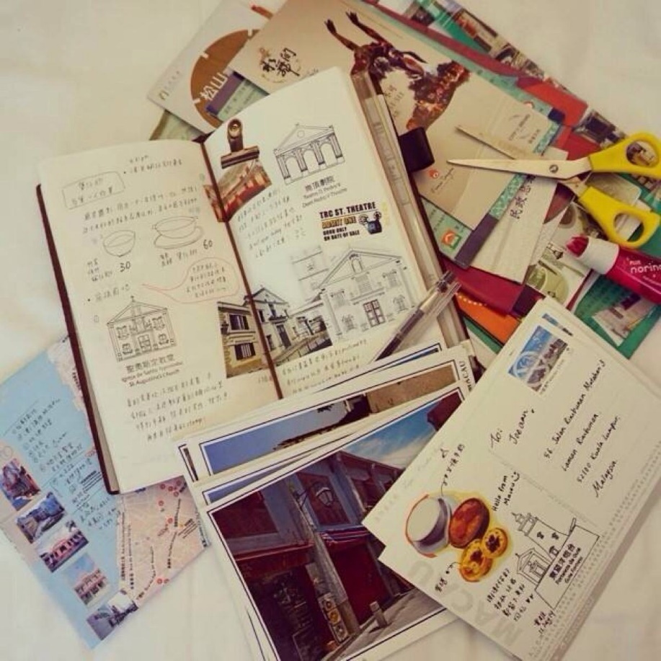
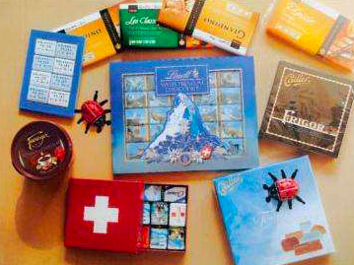
On the way ...
Diary
Journal
Souvenir
...

Slide 5

Transport from airport to Milton

Slide 6

C7-1-1

Slide 7

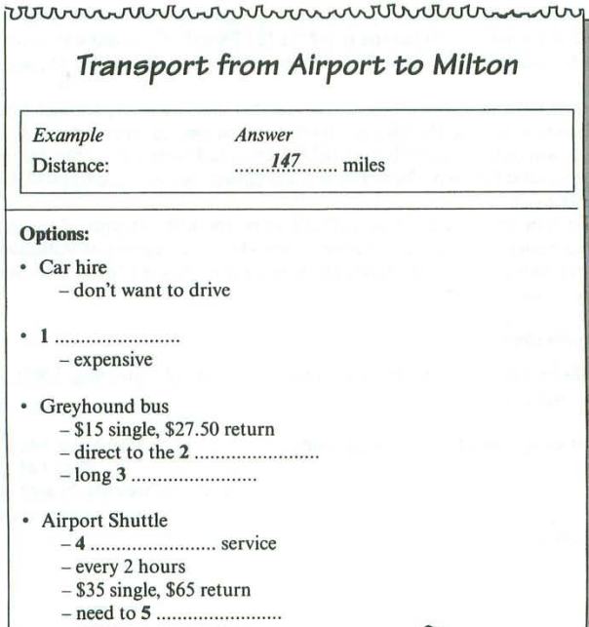

C7-T1-S1 P10

Slide 8
C7-T1-S1 P10
Cab
city center
wait
door to door
reserve

Slide 9
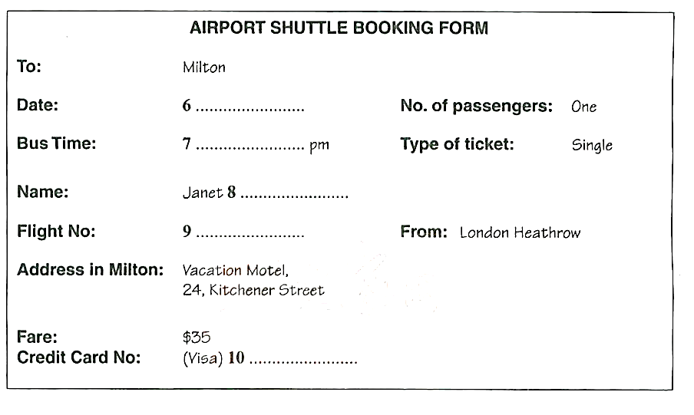
C7-T1-S1 P10

Slide 10

C7-T1-S1 P10
17th October
12.30
Thomson
AC936
3303845020456837

Slide 11
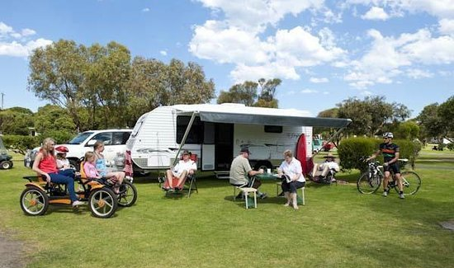
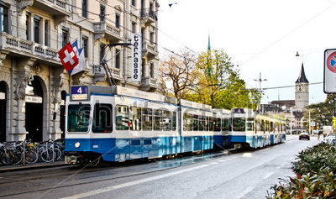
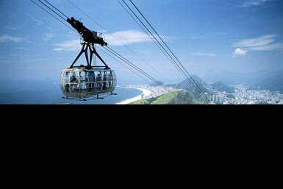
Transportation
Coach
Bus （Minibus）
Minicab
Go On Foot
Bicycle
Electric Tram
Caravan/ Cable Car/ Truck/Camel/Helicopter

Slide 12
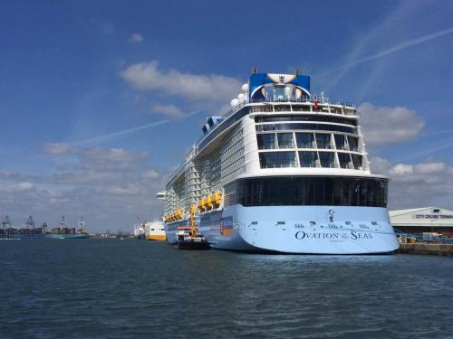
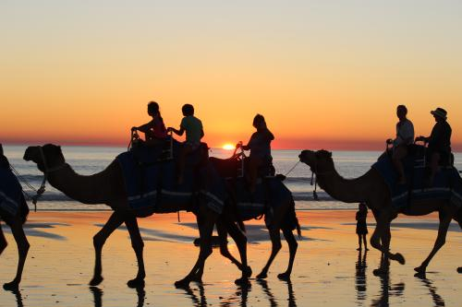
旅游活动
banquet 宴会
barbecue 烧烤
bird watching 看鸟
bushwalk 丛林徒步旅行
camel ride 骑骆驼
cruise 乘船巡游
excursion 远足
rafting 漂流

Slide 13
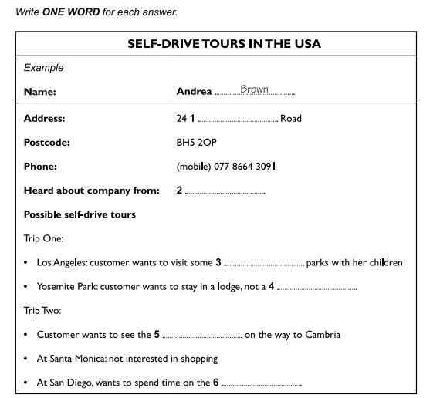
10-1-1 P10

Slide 14
10-1-1 P10
Ardleigh
newspaper
theme
tent
castle
beaches

Slide 15
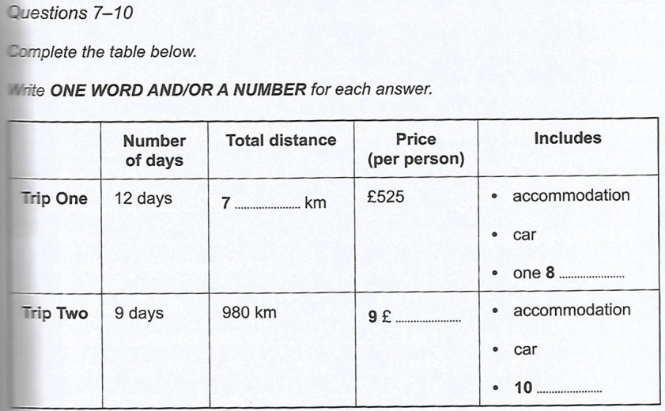

Slide 16
2020
flight
429
dinner

Slide 17
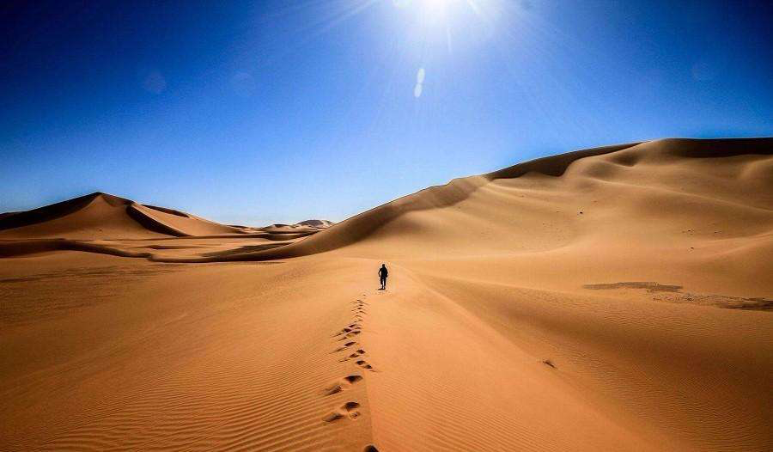
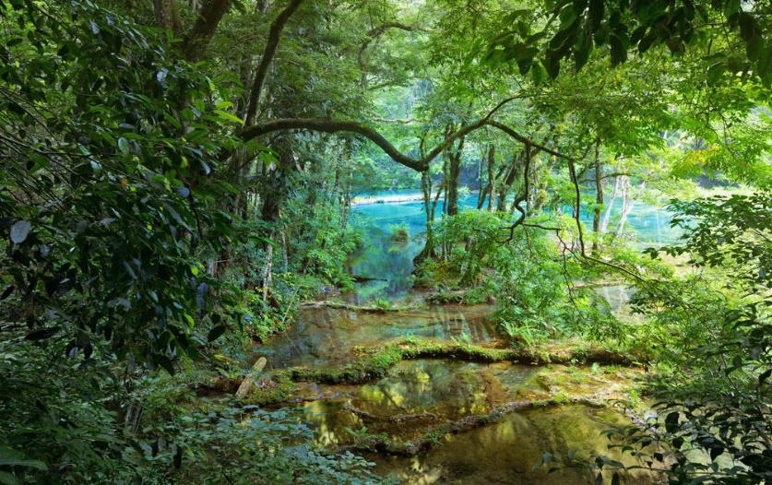
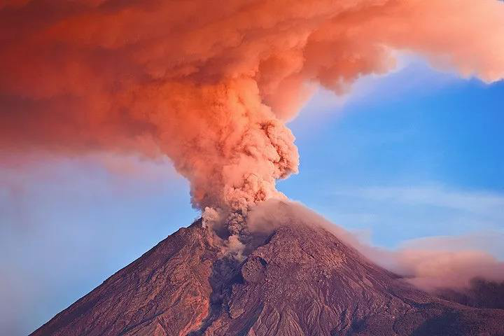
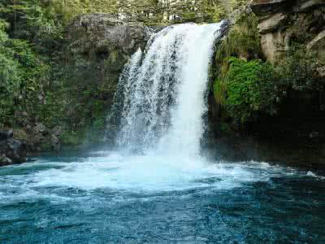
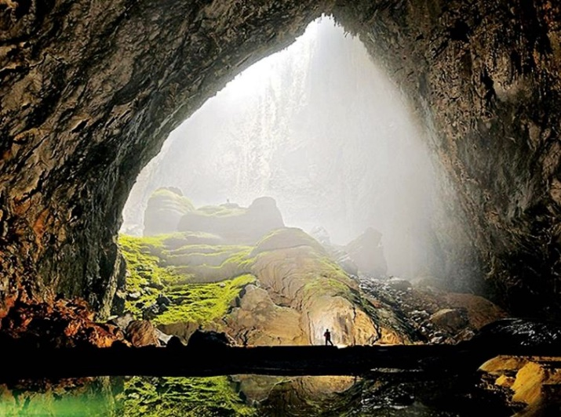
Natural landscape
自然风光
desert
rainforest
volcano
waterfall
cave

Slide 18
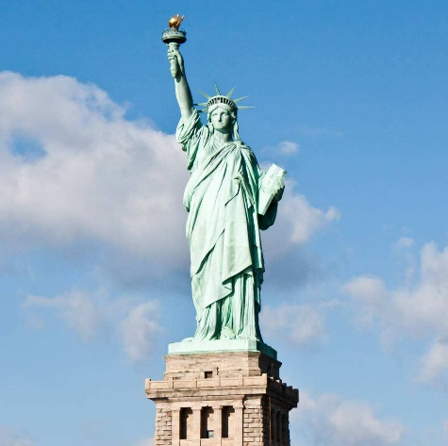
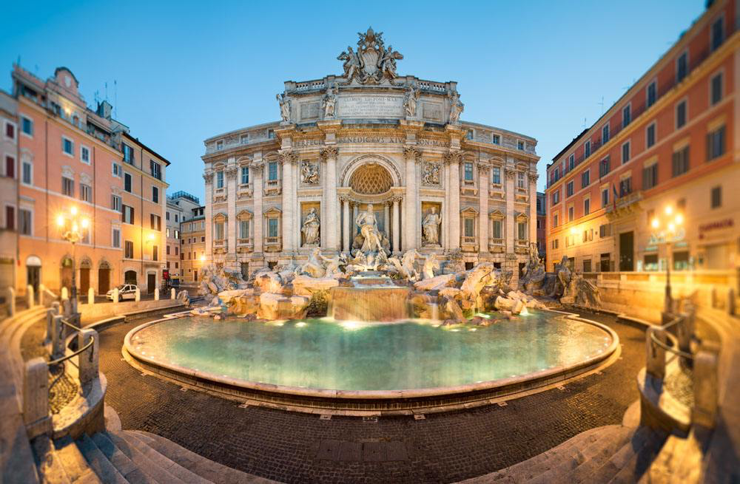
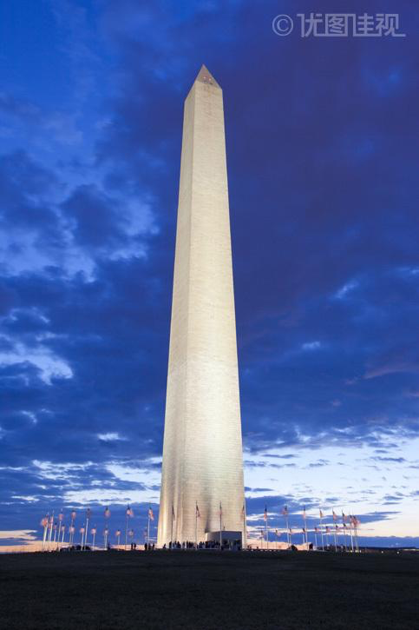
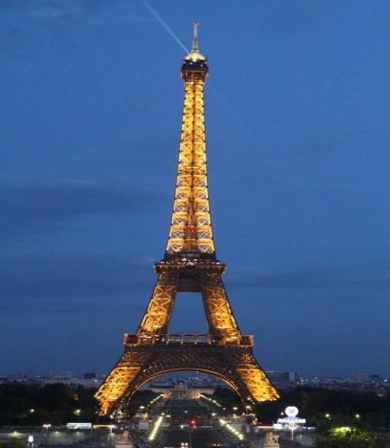
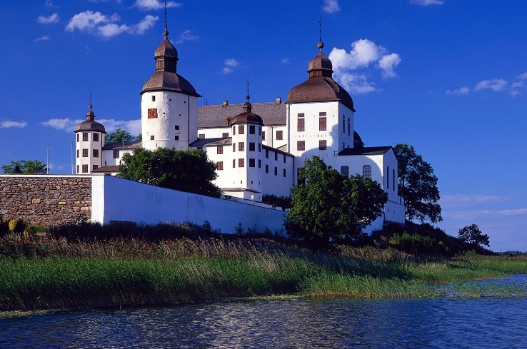
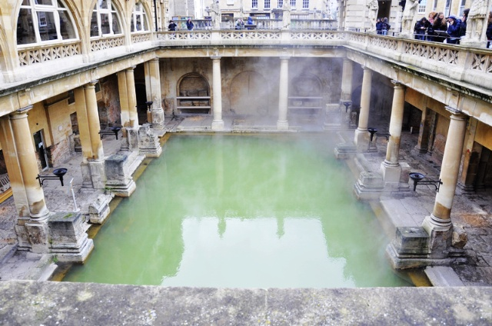
architecture
人文建筑
statue
fountain
monument
tower
castle
hot spring

Slide 19
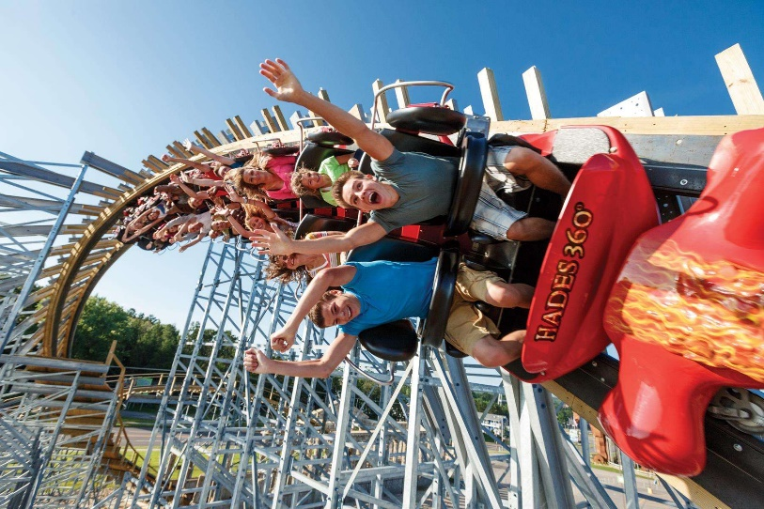
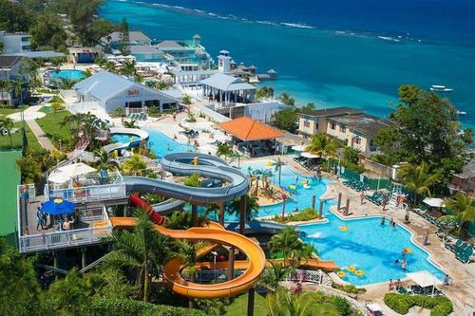
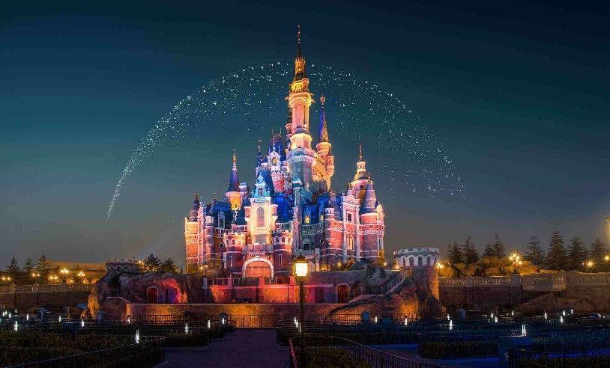
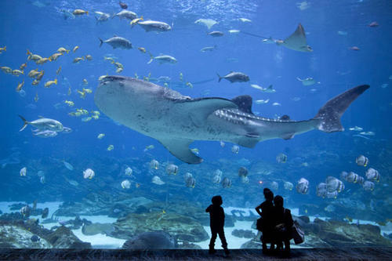
parks
公园
amusement park
water park
theme park
aquarium

Slide 20
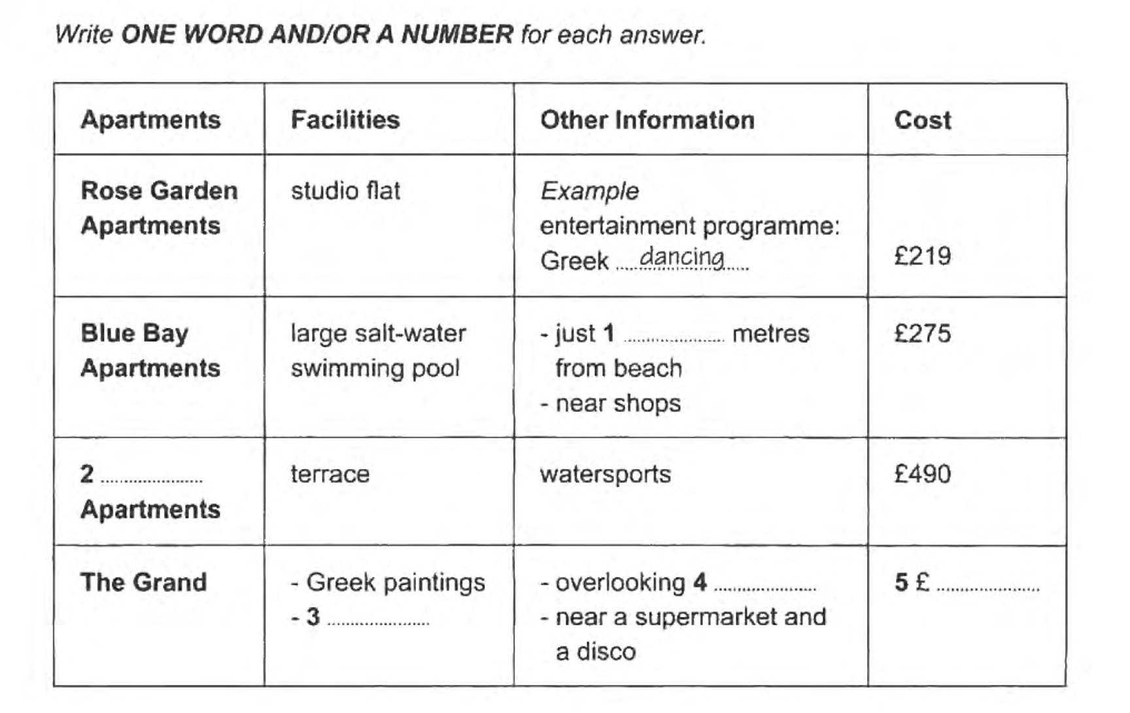
9-3-1 P56-57

Slide 21
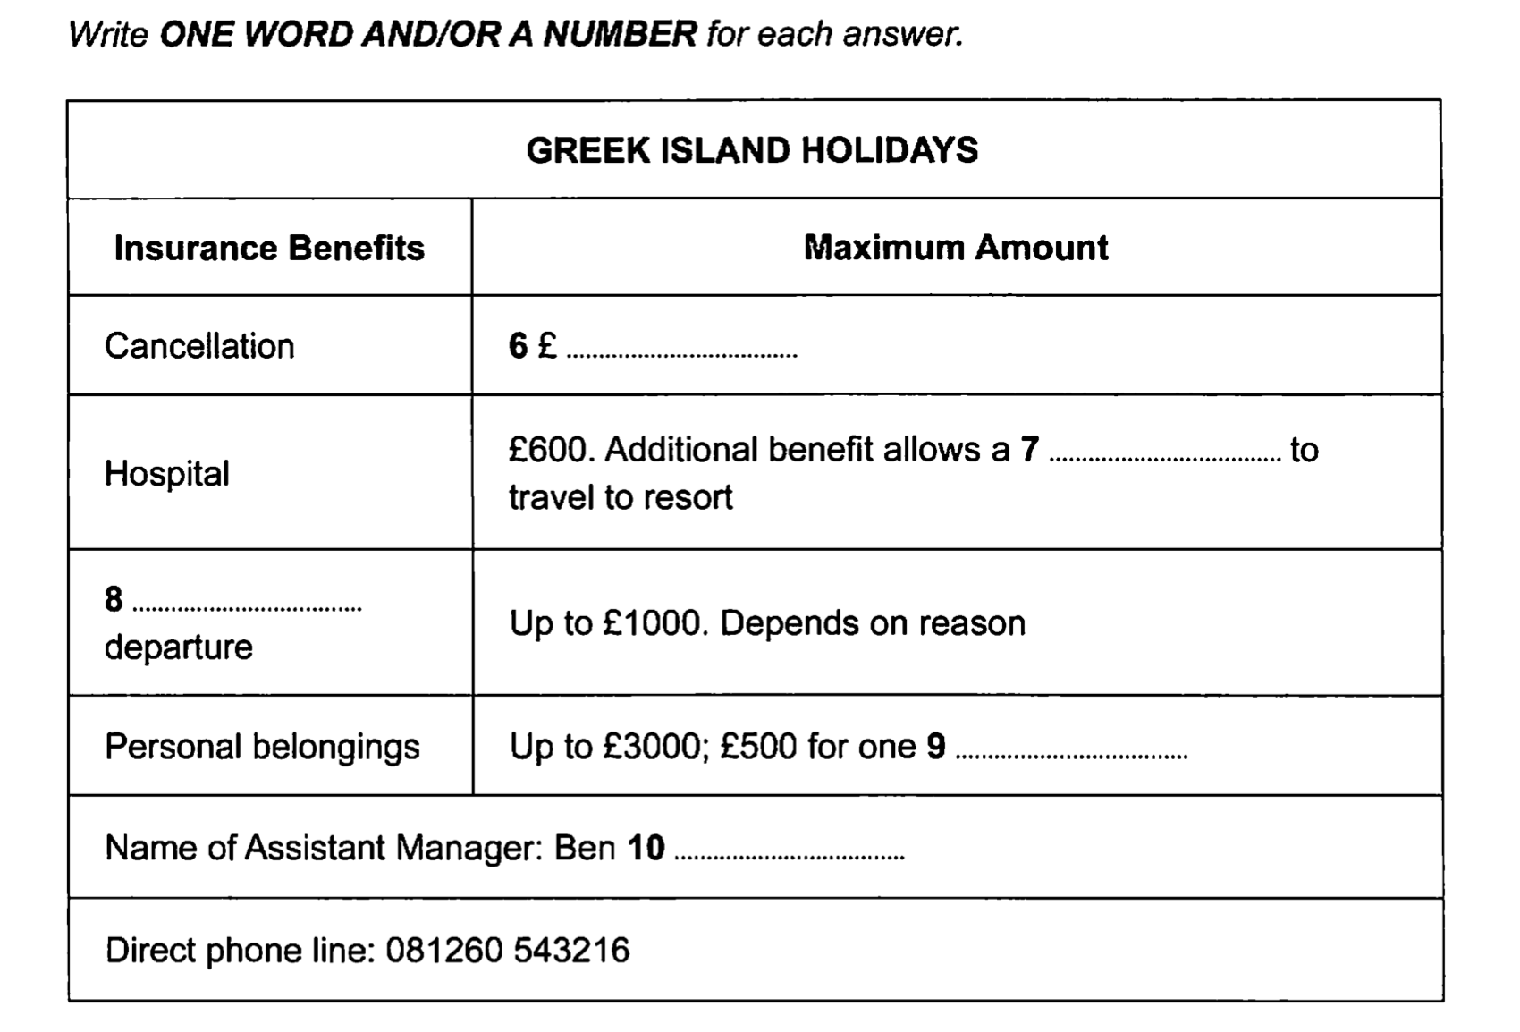
9-3-1 P56-57

Slide 22
9-3-1 P56-57
300
Sunshade
forest/forests
319
balcony

Slide 23
9-3-1 P56-57
10000
relative
missed
item
Ludlow

Slide 24
Methodology
听前：两读两定两判
读字数限制，读场景标题
划题干关键词:
预判空格信息,根据语法预判答案词性
定位词: 专有名词,数字>名词>动词>形容词
限定词: 时间, 地点, 极值, 程度..
听中：
听关键词及其同义替换+逻辑连接词
速记(所听即所得)
听后：
检查拼写、单复数、字数限制、大小写

Slide 25
Homework
听力练习：4-1-1，4-2-1，4-4-1，7-1-1，8-2-1
背诵旅游场景词汇

